Slide 1
Physics 124: Lecture 12
Timers and Scheduled Interrupts

Slide 2
Timer Basics
The Arduino Uno/Nano (ATMega 328) has three timers available to it (Arduino Mega has 6)
  max frequency of each is 16 MHz, (as assembled)
  TIMER0 is an 8-bit timer, with 1, 8, 64, 256, 1024 prescaler options
  TIMER1 is a 16-bit timer, with 1, 8, 64, 256, 1024 prescaler options
  TIMER2 is an 8-bit timer with 1, 8, 32, 64, 128, 256, 1024 prescaler options
These timers, recall, are used for PWM pins 5&6, 9&10, 3&11, respectively
  we saw that we could change the PWM frequency by messing with the frequency prescaler values
  but PWM frequency is not the same as clock frequency

Slide 3
Prescaling & Frequency
The Arduino boards run the ATMega chip at 16 MHz
  so a prescaler of 1 results in a 16 MHz clock
  a prescaler of 1024 results in 15.625 kHz
Recall the PWM table:
  the top frequency is not 16 MHz, off by 256× and 512×
  this is because PWM is (presumably) counting a certain number of clock cycles (256 or 512) between actions
PWM pins | Register | scaler values | frequencies (Hz)
5, 6 | TCCR0B | 1, 2, 3, 4, 5 | 62500, 7812, 977, 244, 61.0
9, 10 | TCCR1B | 1, 2, 3, 4, 5 | 31250, 3906, 488, 122, 30.5
3, 11 | TCCR2B | 1, 2, 3, 4, 5, 6, 7 | 31250, 3906, 977, 488, 244, 122, 30.5

Slide 4
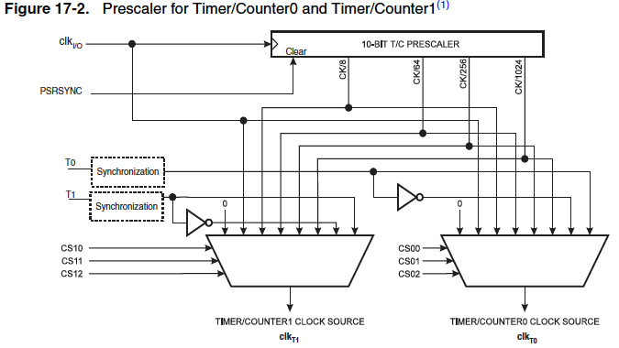
Prescaling Implementation on-chip
From ATMega full datasheet
  CS bits decide which tap to output (note orig. clock in pos. 1)

Slide 5
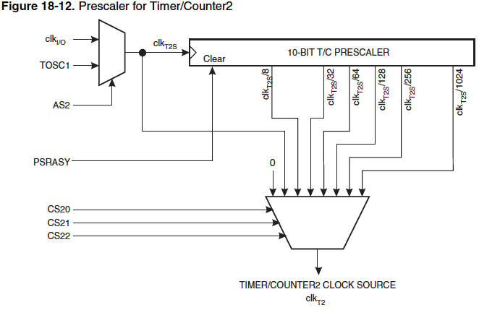
Prescaling for TIMER2: more taps
CSn0:CSn2 = 0 selects this: no clock out

Slide 6
Wrap Times
TIMER0 is 8-bit (0−255)
  when prescaler = 1, reaches full count in 16 μs
  when prescaler = 1024, full count in 16.384 ms
TIMER1 is 16-bit (0−65536)
  when prescaler = 1, reaches full count in 4.096 ms
  when prescaler = 1024, full count in 4.194 seconds
TIMER2 is 8-bit (0−255)
  when prescaler = 1, reaches full count in 16 μs
  when prescaler = 1024, full count in 16.384 ms
These wrap times set limits on timed interrupts
  makes TIMER1 attractive, for its 16 bits

Slide 7
Timed Interrupts
Really handy to have timed action, despite whatever loop() is doing
  could check for serial or other input on a regular basis
  could read analog signal for regular sampling
  could produce custom signal at specific frequency
Idea is to set up timer so when it reaches specified count, it creates an interrupt
  and also resets counter to zero so cycle begins anew
Interrupt Service Routine (ISR) should be short and sweet
  performs whatever periodic task you want

Slide 8
CAUTION
Messing with timer configurations can compromise other timer-based functions like
  PWM outputs: analogWrite() (diff. pins → diff. timers)
  delay() (uses timer0, depends on counter wrap)
  millis() and micros() (uses timer0, dep. on wrap)
  Servo library (uses timer1)
  tone() (uses timer2)
  but delayMicroseconds() is okay (not timer-based)
  others?
Be cognizant of which timer each function uses
  see http://letsmakerobots.com/node/28278

Slide 9
TIMER1 as Example
Relevant registers for setting up timer:
  TCCR1A: Timer/Counter1 Control Register A
    sets up mode of operation
  TCCR1B: Timer/Counter1 Control Register B
    more mode control, and prescaler
  OCR1A: Output Compare Register 1 A (there’s also a B)
    value against which to compare
  TIMSK1: Timer1 Interrupt MaSK register
    selects which OCR to use
  TIFR1: Timer1 Interrupt Flag Register
    contains info on tripped interrupt status
  TCNT1: actual 16-bit count
  TCNT1 and OCR1A break into, e.g., TCNT1H and TCNT1L high and low bytes (registers) to accommodate 16 bits

Slide 10
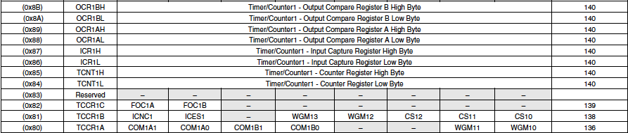
Timer 1 Registers
From short datasheet
  page reference is for full datasheet
Note 16-bit quantities need two registers apiece
  H and L for high and low

Slide 11


TCCR1A
Upper bits are Compare Output Mode
  sets behavior of Compare Match condition
  can toggle, clear or set OCR bits on Compare Match condition
Lower bits are 2/4 Waveform Generation Mode controls
  other two are in TCCR1B
  16 possibilities, the ones we’re likely interested in:
    CTC is Clear Timer on Compare match (so starts count all over)

Slide 12

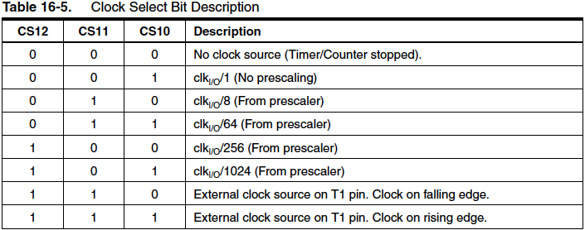
TCCR1B
We’ve seen this before, for prescaling
  two bits for Input Capture (noise cancel and edge sense)
  has upper two bits of WGM1
  has three CS (Clock Select) bits for prescaling, or ext. clock

Slide 13


OCR1A and TIMSK1
This is the value against which TCNT1 (L & H) is compared (also a OCR1B for alternate value)
TIMSK1 controls what generates interrupts
  ICIE: Input Capture Interrupt Enable
  OCIE A/B Output Compare Match Interrupt Enable
  TOIE: Timer Overflow Interrupt Enable: when counter wraps

Slide 14

Finally, TIFR1
Timer1 Interrupt Flag Register
  ICF1 set if Internal Capture interrupt has occurred
  OCF1B set if Output Compare match occurs on OCR1B
  OCF1A set if Output Compare match occurs on OCR1A
  TOV1 set if OVerflow (wrap) occurs on counter (in certain modes)

Slide 15
What Do We Do with this Power?
Let’s set up an interrupt timer to change the state of an LED every 1.5 seconds
Need TIMER1 if we want to reach beyond 16 ms
  prescale by 1024, so frequency is 15625 ticks/sec
  thus 1.5 seconds corresponds to 23437 ticks
Set up registers:
  TCCR1A to 0 (ignore COM1A; WGM10=WGM11=0 for CTC)
  TCCR1B: set WGM12 (for CTC), CS12, CS10
  OCR1A to 23437 (OCR1AH = 91, OCR1AL to 141)
  TIMSK1: set OCIE1A
Make ISR function: ISR(TIMER1_COMPA_vect){}

Slide 16
Example: Interrupt-Driven LED blink
const int LED=13; // use on-board LED
volatile int state=0;
void setup(){
pinMode(LED,OUTPUT); // set up LED for OUTPUT
TCCR1A = 0; // clear ctrl register A
TCCR1B = 0; // clear ctrl register B
TCCR1B |= (1 << WGM12); // set bit for CTC mode
TCCR1B |= (1 << CS12); // set bit 2 of prescaler for 1024x
TCCR1B |= (1 << CS10); // set bit 0 of prescaler for 1024x
OCR1A = 23437; // set L & H bytes to 23437 (1.5 sec)
TIMSK1 |= (1 << OCIE1A); // enable interrupt on OCR1A
TCNT1 = 0; // reset counter to zero
}
void loop(){
delay(10000); // provide lengthy task to interrupt
}
ISR(TIMER1_COMPA_vect){ // results in interrupt vector in asm code
state += 1;
state %= 2; // toggle state 1 --> 0; 0 --> 1
digitalWrite(LED,state); // export value to pin
}

Slide 17
Comments on Code
The bit values WGM12, CS10, etc. are defined in, e.g., iom328p.h
  in hardware/tools/avr/avr/include/avr/
  for example:
#define CS10 0
#define CS11 1
#define CS12 2
#define WGM12 3
#define WGM13 4
#define ICES1 6
#define ICNC1 7
#define OCR1A _SFR_MEM16(0x88)
#define OCR1AL _SFR_MEM8(0x88)
#define OCR1AH _SFR_MEM8(0x89)
#define TIMER1_COMPA_vect _VECTOR(11) // Timer1 Compare Match A

Slide 18
Handling the Interrupt
The command ISR(TIMER1_COMPA_vect) creates a “vector” pointing to the program memory location of the piece that is meant to service the interrupt
  near beginning of assembly code listing:
  vector 11 is specially defined in ATMega 328 to correspond to a comparison match to OCR1A on timer 1
  when this particular sort of interrupt is encountered, it’ll jump to program location 0x100, where:
    various working registers are PUSHed onto the STACK
      so the service function can use those registers for itself
    the interrupt service functions are performed
    the STACK contents are POPped back into registers
    the program counter is reloaded with the pre-interruption value
The vector approach allows use of multiple interrupts
2c: 0c 94 80 00 jmp 0x100 ; 0x100 <__vector_11>

Slide 19
A Custom PWM
ISR(TIMER1_COMPA_vect)
{
if (state) OCR1A = 31248; // two seconds for OFF
else OCR1A = 15624; // one second for ON
state += 1;
state %= 2;
digitalWrite(LED,state);
}
When time is up:
  if state == 1 (LED ON), set compare register to 2 seconds
  otherwise (LED OFF), set compare register to 1 second
In this way, you can customize a PWM-like signal arbitrarily
  pretty sure this is what the Servo library is doing with TIMER1

Slide 20
Nested Interrupts
Imagine you want to respond to an external interrupt, and perform some follow-up action 2 seconds later
  external interrupt arranged via attachInterrupt()
  within service function, set up TIMER1 counter for timed interrupt
  in timer ISR, reset TIMER1 to normal mode
    disable interrupt condition, or you’ll keep coming back

Slide 21
References and Announcements
For more on timer interrupts:
  http://www.instructables.com/id/Arduino-Timer-Interrupts/
  http://letsmakerobots.com/node/28278
Announcements
  Will review proposals over weekend
  Offer feedback, redirect, order parts (some) early in week
  New Lab times:
    TBA
    will have someone there, often two of us
  Light tracker demo/code/paragraphs due 2/14 or 2/15
  Midterm on 2/15

